Slide 1
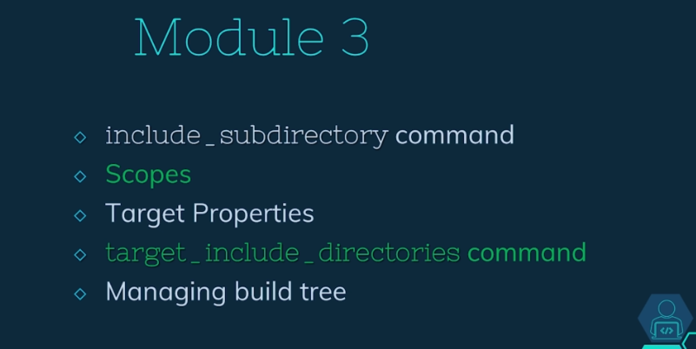

Subdirectory
  Concept of subdir
  include_subdirectory command

Slide 2
Installation
  How to find a package – commands for CMakeFiles
  For other project to be able to locate it
find_packe(<package_name>)

Slide 3
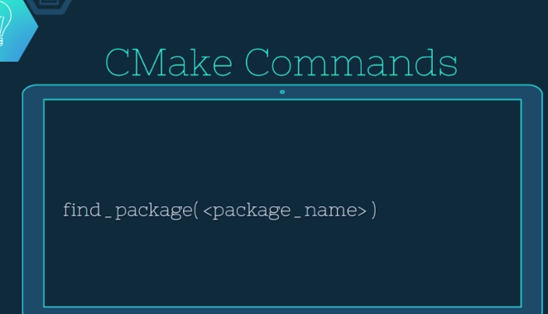
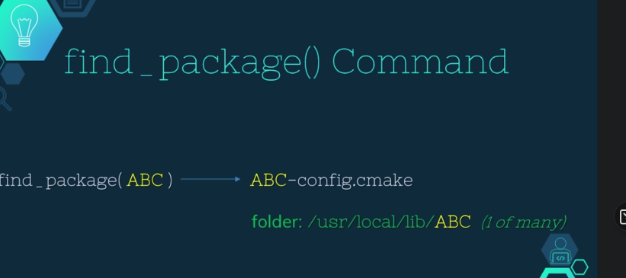
Requirements to run CMake
  For other project to be able to locate it

Slide 4
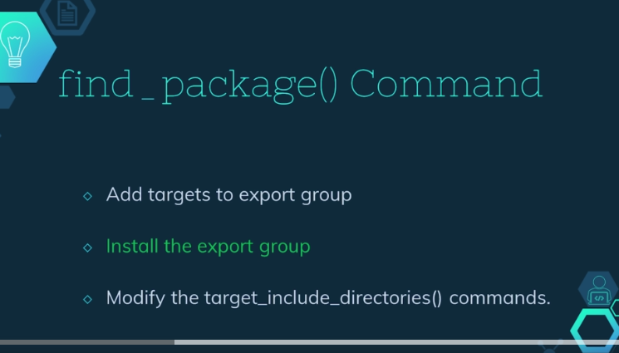
Requirements to run CMake
  Minimum version requirement – developer must test

Slide 5
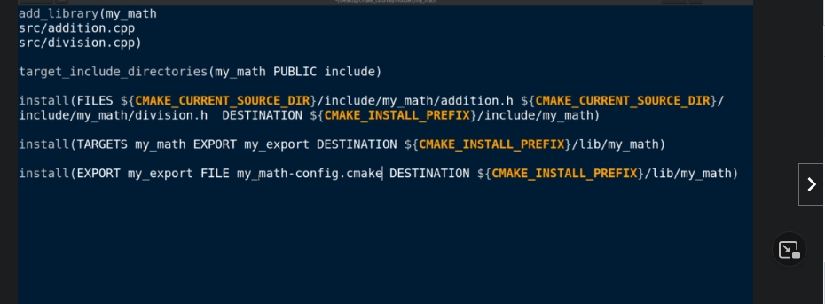
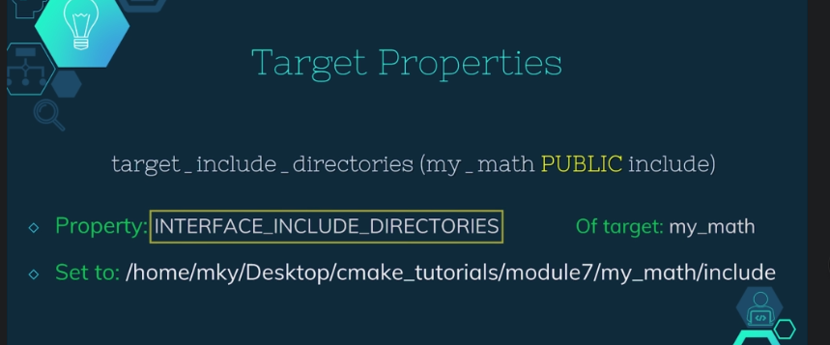
Requirements to run CMake
  Enough to install any lib

Slide 6
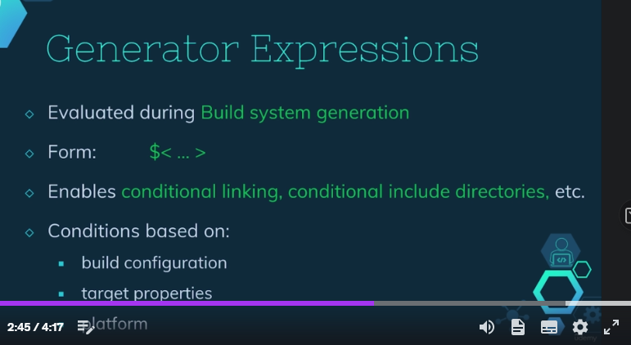
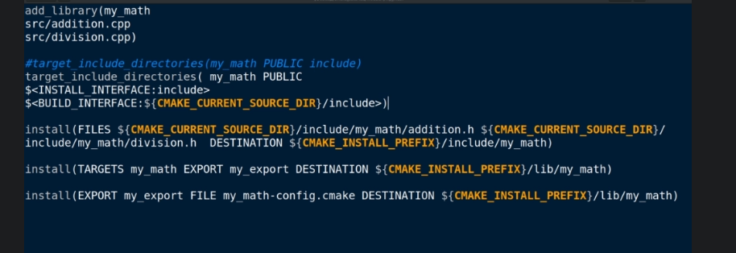
Requirements to run CMake
  To solve generator expr – in building stage resolved and not in generator stage

Slide 7
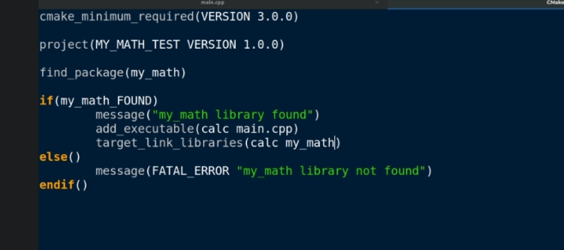
Requirements to run CMake
  Minimum version requirement – developer must test

Slide 8
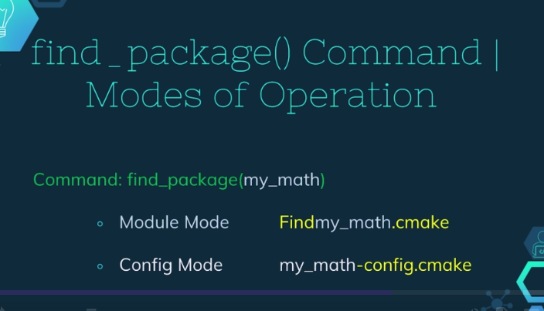
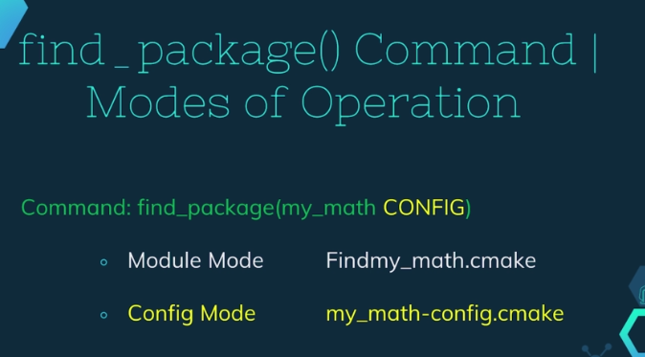
Requirements to run CMake
  Config or module option, if no option – first searched in module mode, then in confg

Slide 9
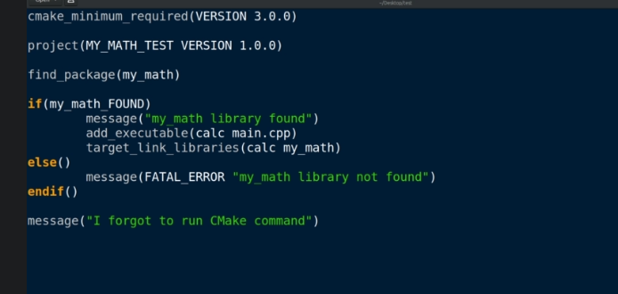
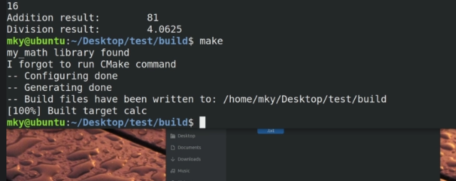
Requirements to run CMake
  If we edited cmakefile and forgot to run cmake the maketool ill run cmake for us, not available when first time building project – there is no makefile yet

Slide 10
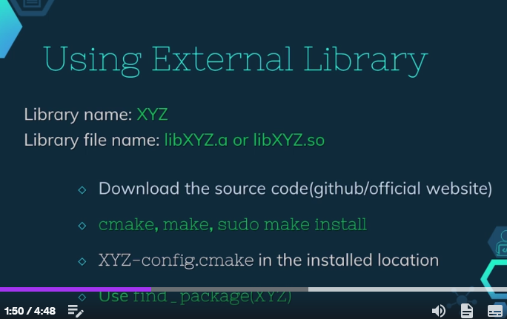
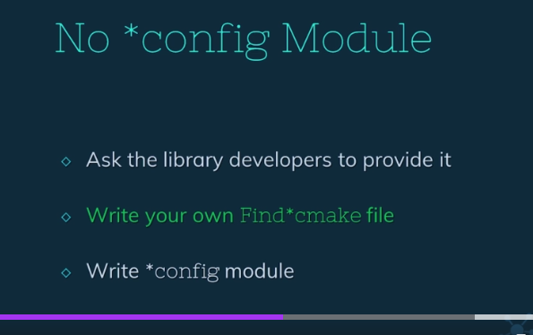
Requirements to run CMake
  Linking external lib XYZ

Slide 11
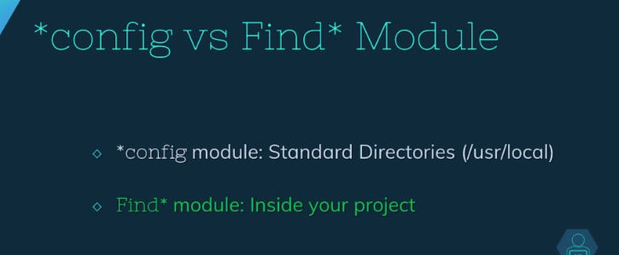
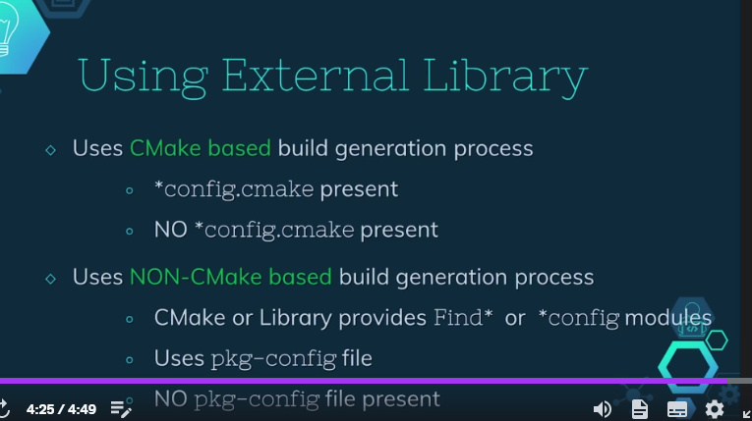
Requirements to run CMake
  Minimum version requirement – developer must test

Slide 12
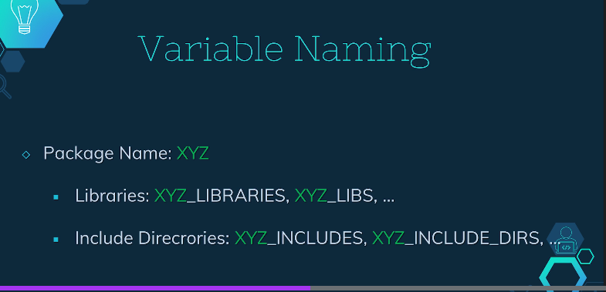
Requirements to run CMake
  Common trend
  In *Congif.cmake

Slide 13
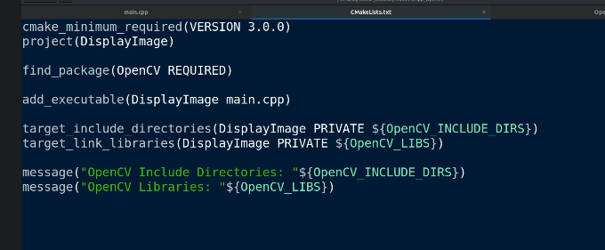
Requirements to run CMake
  Minimum version requirement – developer must test

Slide 14
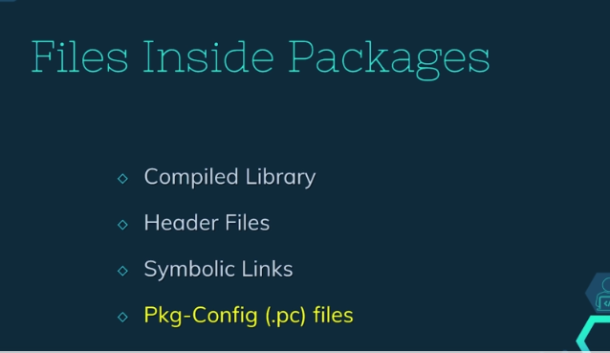
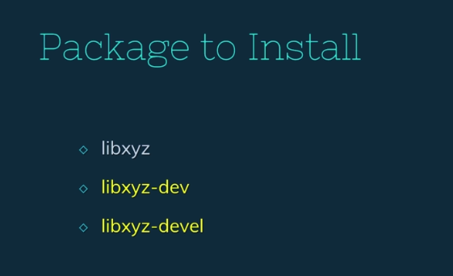
Requirements to run CMake
  Package with pkg

Slide 15
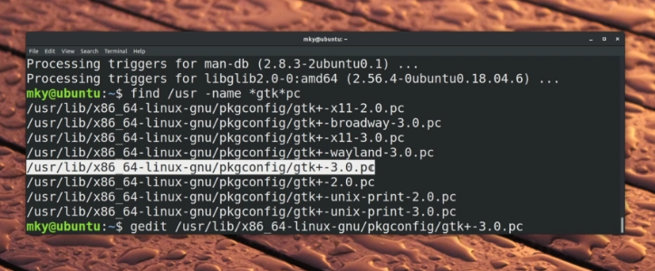
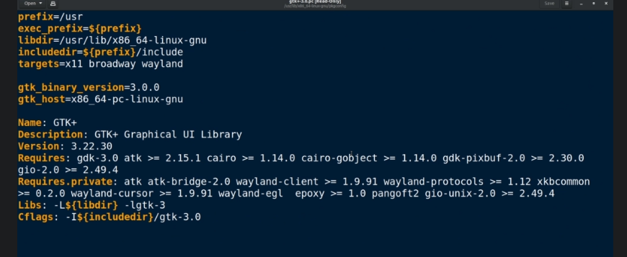
Requirements to run CMake
  Minimum version requirement – developer must test

Slide 16
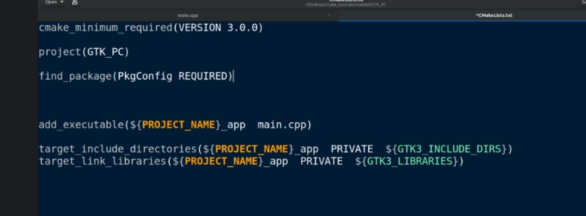
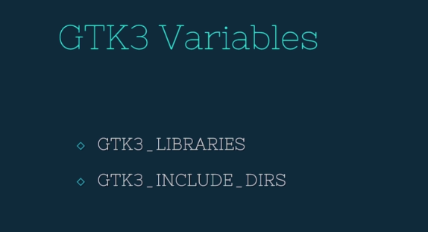
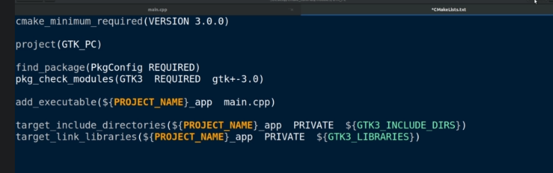
Requirements to run CMake
  The modules are found – it will set variables for us

Slide 17
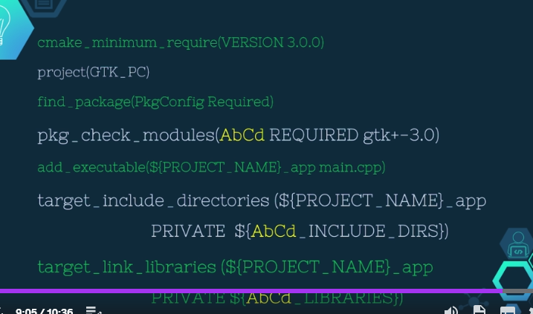
Requirements to run CMake
  Minimum version requirement – developer must test

Slide 18
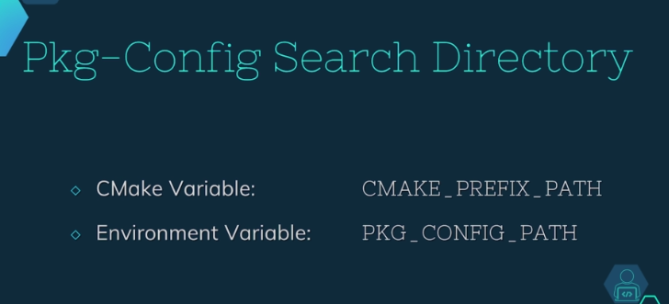
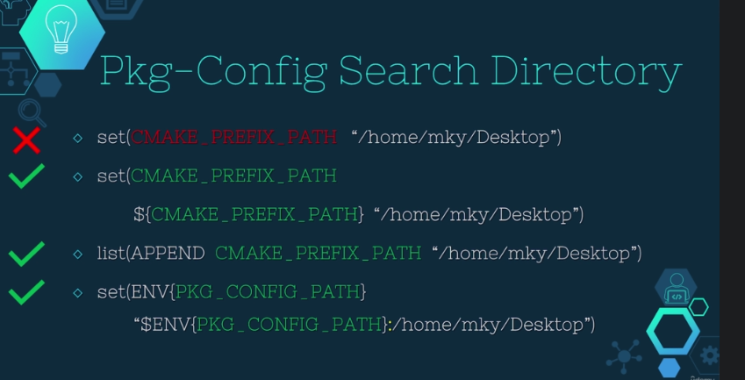
Requirements to run CMake
  We can modify the path – better append than overwrite

Slide 19
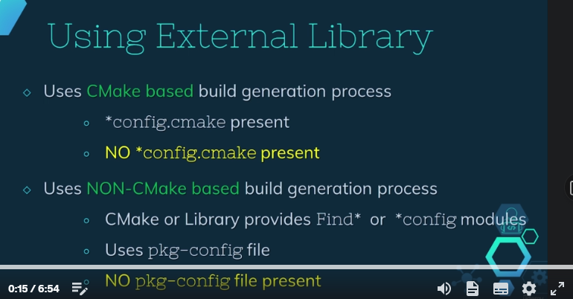
Requirements to run CMake
  When no config nor pc files

Slide 20
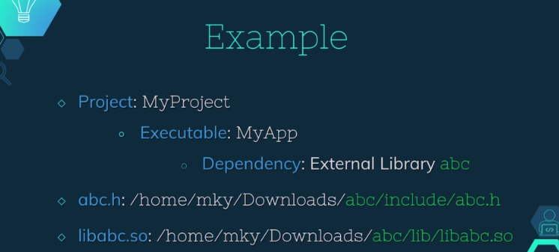
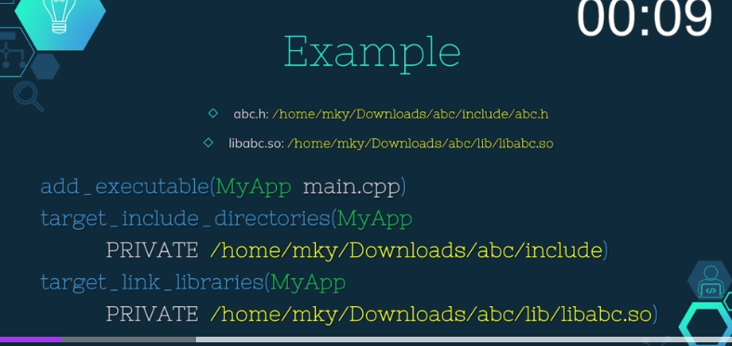
Requirements to run CMake
  Simplest way – provide full path during linking

Slide 21
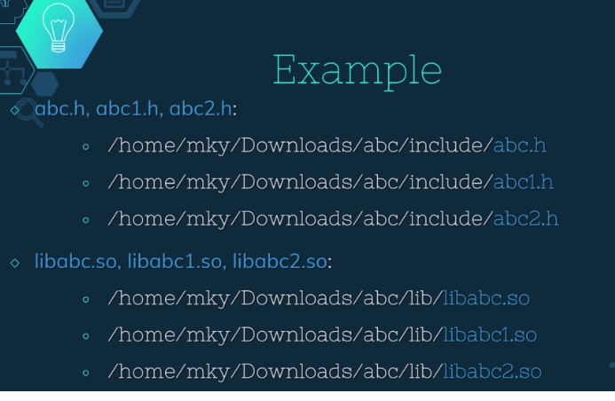
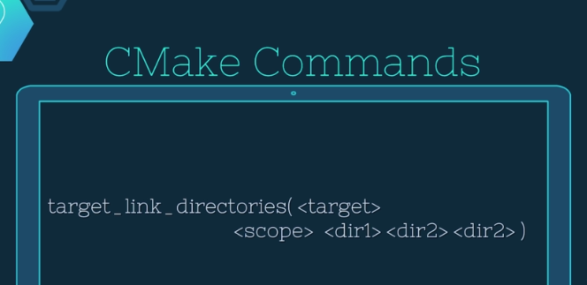
Requirements to run CMake
  Instead of a lot of paths (the same) we can specify the list of dirs. For searching the paths

Slide 22
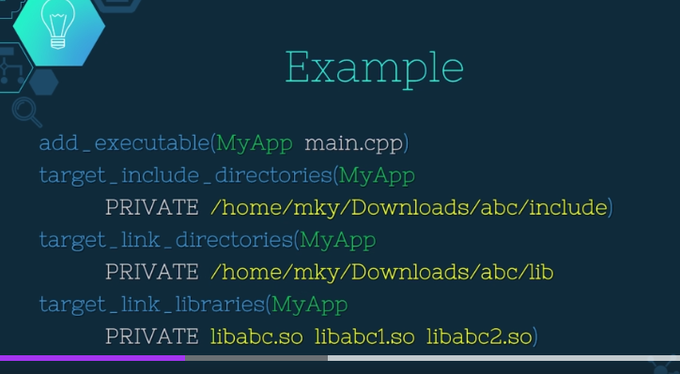
Requirements to run CMake
  Minimum version requirement – developer must test

Slide 23
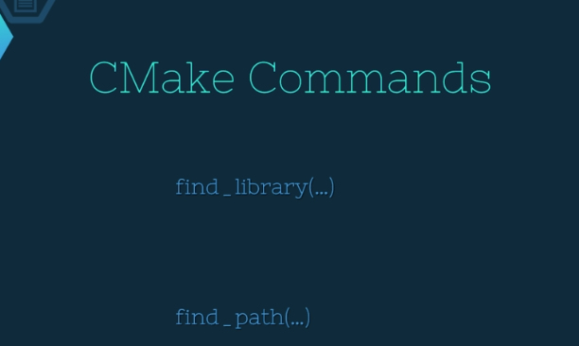
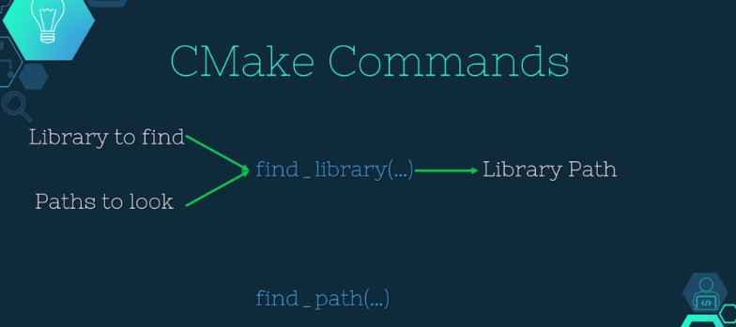
Requirements to run CMake
  For complicated structure
  Find library – takes lib name and probable paths where it can exist, once found – location stored in variable

Slide 24
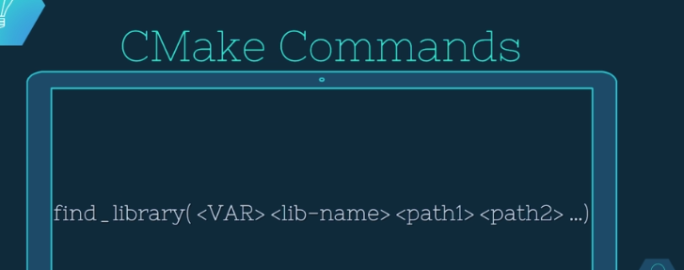
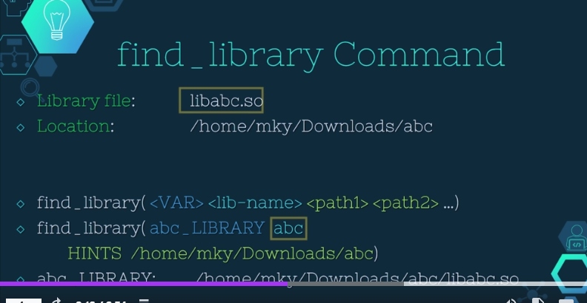
Requirements to run CMake
  Minimum version requirement – developer must test

Slide 25
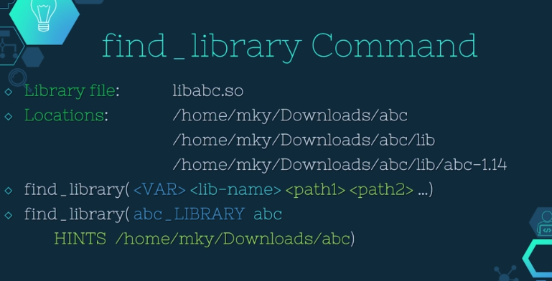
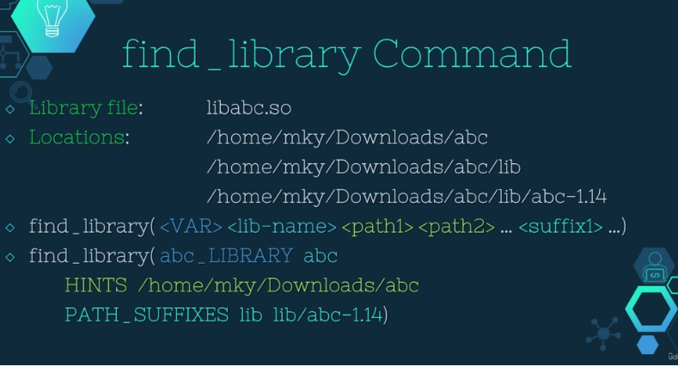
Requirements to run CMake
  What is lib in subdirectory, by default it will not look for it, we need to add them to search

Slide 26
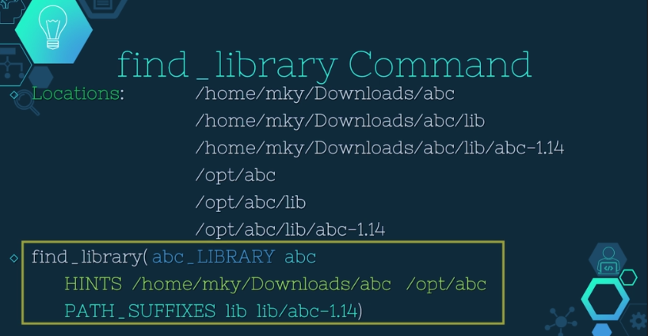
Requirements to run CMake
  Minimum version requirement – developer must test

Slide 27
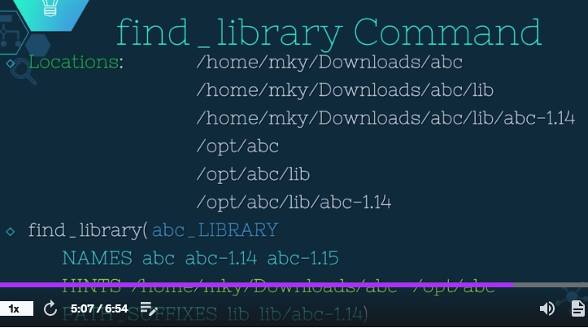
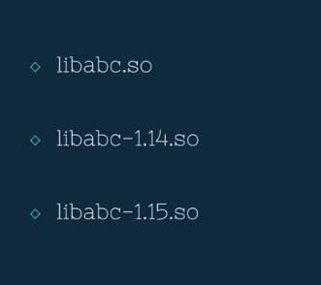
Requirements to run CMake
  If not sure about the name

Slide 28
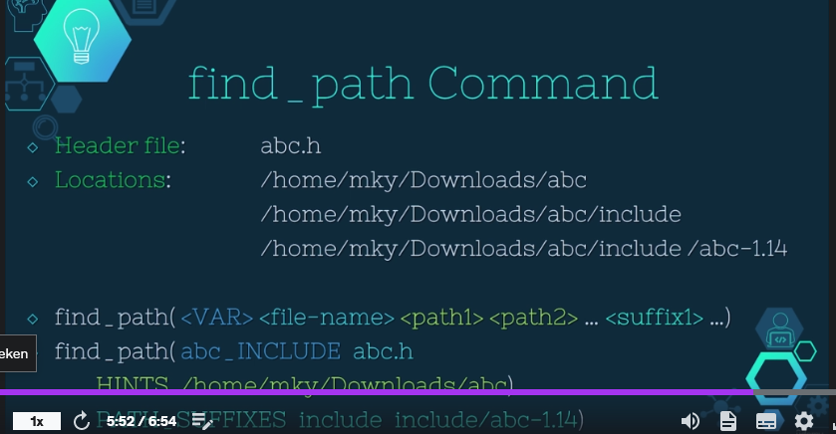
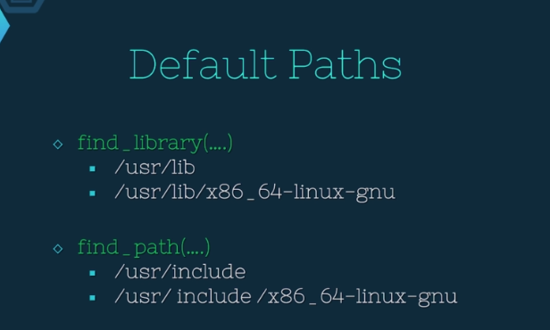
Requirements to run CMake
  Find path almost the same
  When we execute find path or lib – it is going to look in lib or path mentioned, but before it will search in default loc

Slide 29
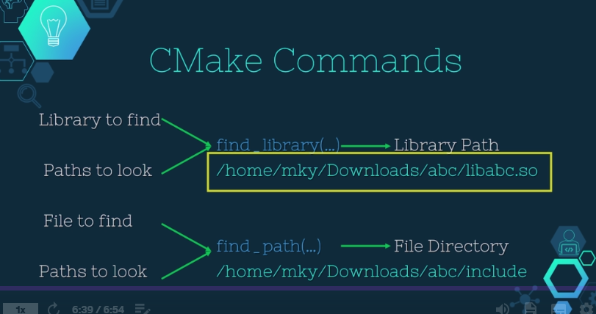
Requirements to run CMake
  Lib – will after execution abc_library – will contain a full path of library, abd_include – will contain only directory location of the file

Slide 30
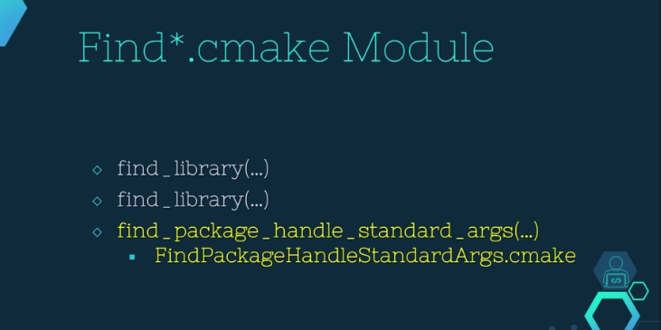
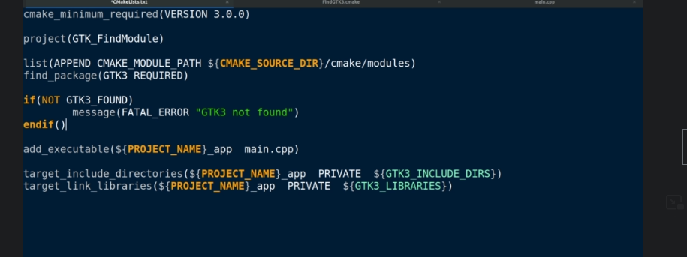
Requirements to run CMake
  Find package standar

Slide 31
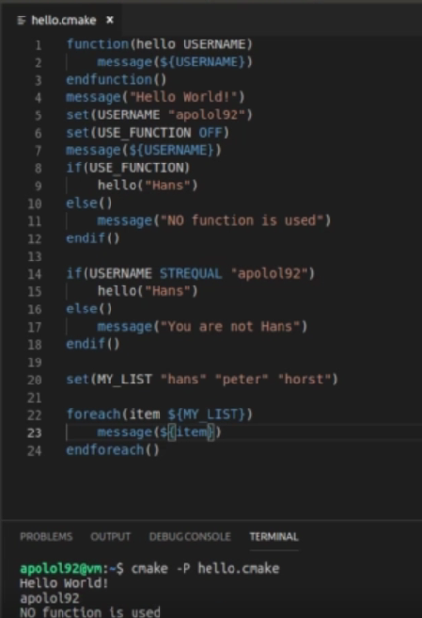
Requirements to run CMake
  Set (USE_FUNCTION ON) TRUE YES OFF

Slide 32
Requirements to run CMake
  Ctest executable in Cmake that runs tests
  Lets install google tests (gtest)

Slide 33

Requirements to run CMake
  Optional packages do not prevent installation – install open cv on the cluster

Slide 34
Requirements to run CMake
  https://docs.opencv.org/4.x/d7/d9f/tutorial_linux_install.html
1007 2022-11-16 15:13:32 mkdir opencv
1008 2022-11-16 15:13:34 cd opencv/
1009 2022-11-16 15:13:45 wget -O opencv.zip https://github.com/opencv/opencv/archive/4.x.zip
1010 2022-11-16 15:14:04 unzip opencv.zip
1013 2022-11-16 15:14:54 module av CMake
1014 2022-11-16 15:15:03 module load CMake/3.20.1-GCCcore-6.4.0
1019 2022-11-16 15:15:44 cd opencv-4.x/
1020 2022-11-16 15:15:48 mkdir build
1021 2022-11-16 15:15:50 cd build/
1022 2022-11-16 15:15:52 cmake ..
2022-11-16 15:20:43 cmake .. -DCMAKE_INSTALL_PREFIX=/data/leuven/304/vsc30468/opencv
Make –j36

Slide 35


Requirements to run CMake
  If does not find require dep will throw and error
  Without required leyword – it will be treated as optional package
  Case sensitive – file does not exist

Slide 36


Requirements to run CMake
  installation

Slide 37
Writing CMakeLists.txt Files
CMake language evolved while in use
Scripting language with simple syntax
  Comments
  Commands
  Lists
  Variables
  Control structures
Processed during CMake configure phase
# Comment ends at a newline
COMMAND(arg1 arg2 ...)
A;B;C # Semicolon-separated
${VAR}
IF(CONDITION)

Slide 38
Commands
COMMAND(ARG “ARG WITH SPACES”
${A_LIST} “${A_STRING}”)
Simple syntax:
Each command must start on its own line
Variable references are replaced by values
Lists in unquoted arguments are expanded
Argument meanings defined by command
Both positional and keyword arguments used
TARGET_LINK_LIBRARIES(myTarget lib1 lib2)
FIND_LIBRARY(MY_LIB NAMES my1 my2
PATHS /foo /bar)

Slide 39
Debug vs Release
  When you want to use an external library in the Debug/Release mode.
    Firstly, you will download the external library's source codes and compile it in both debug and release modes. You MUST have separate folders containing the debug binaries and release binaries. Say the external debug library is in /some/path/foo/debug/libfoo.so and the release library is in /some/path/foo/release/libfoo.so .
    Say, the executable in your project is called my_app then you can use the following command in my_app project's CMakeLists.txt file, to link the external foo liibrary.
  target_link_libraries( my_app
  debug /some/path/foo/debug/libfoo.so
  optimized /some/path/foo/release/libfoo.so)
  Now, when you will run
  cmake -DCMAKE_BUILD_TYPE=Debug ..
  while generating the build files for my_app project , /some/path/foo/debug/libfoo.so will be linked against my_app.
  Similarly, when you will run
  cmake -DCMAKE_BUILD_TYPE=Release ..
  /some/path/foo/release/libfoo.so will be linked against my_app.
  Note here that, running the cmake.. command i.e. without any build type will throw an error.

Slide 40
Requirements to run CMake
Debug/Release Mode
Q: How can we handle different build configurations like debug, release etc. using CMakeLists.txt file?
A: There are these 2 case scenarios:
1. You are making a project, which does not dependent on any external library. In this case, you can directly set a normal variable CMAKE_BUILD_TYPE to Debug or Release, while generating build system files. To do that, simply execute
cmake -DCMAKE_BUILD_TYPE=Debug .. or
cmake -DCMAKE_BUILD_TYPE=Release .. commands.
You will see that the release build is faster and also has less file size compared to the debug build. When you set the CMAKE_BUILD_TYPE variable, the compiler flags are automatically modified to offer you the desired optimization levels.
2. You want to use an external library in the Debug/Release mode.
2a. Firstly, you will download the external library's source codes and compile it in both debug and release modes. You MUST have separate folders containing the debug binaries and release binaries. Say the external debug library is in /some/path/foo/debug/libfoo.so and the release library is in /some/path/foo/release/libfoo.so .
2b. Say, the executable in your project is called my_app then you can use the following command in my_app project's CMakeLists.txt file, to link the external foo liibrary.
target_link_libraries( my_app
debug /some/path/foo/debug/libfoo.so
optimized /some/path/foo/release/libfoo.so)
Now, when you will run
cmake -DCMAKE_BUILD_TYPE=Debug ..
while generating the build files for my_app project , /some/path/foo/debug/libfoo.so will be linked against my_app.
Similarly, when you will run
cmake -DCMAKE_BUILD_TYPE=Release ..
/some/path/foo/release/libfoo.so will be linked against my_app.
Note here that, running the cmake.. command i.e. without any build type will throw an error.

